Slide 1


Analysis of User Ratings on Global Video Game Sales

Slide 2


Overview
Today’s video game industry is massive and highly competitive.
Determining what games to invest time and resources into can be vital for the success of a developer.
Does the User Score rating of a game affect the sales of that game?
=
?

Slide 3
Dataset Information
Video Game Sales with Ratings
Information about each game
Sales information
Ratings information from a Metacritic webcrawl
Link to Dataset:
https://www.kaggle.com/rush4ratio/video-game-sales-with-ratings

Slide 4
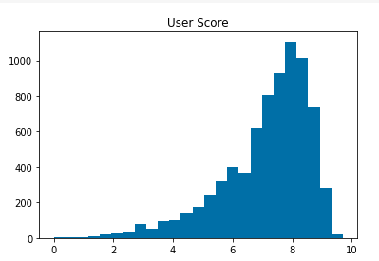
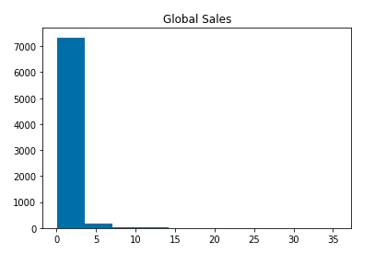
Dataset Details
# Column Non-Null Count Dtype
0 name 7589 non-null object
1 platform 7589 non-null object
2 year_of_release 7462 non-null float64
3 genre 7589 non-null object
4 publisher 7583 non-null object
5 na_sales 7589 non-null float64
6 eu_sales 7589 non-null float64
7 jp_sales 7589 non-null float64
8 other_sales 7589 non-null float64
9 global_sales 7589 non-null float64
10 critic_score 7016 non-null float64
11 critic_count 7016 non-null float64
12 user_score 7589 non-null float64
13 user_count 7589 non-null float64
14 developer 7578 non-null object
15 rating 7503 non-null object
dtypes: float64(10), object(6)

Slide 5
Experiment
Hypothesis
Ho - User rating has no relation to video game sales.
Ha - There is a significant difference in the sales of games with higher review ratings.
Methods
t-testing the main and sub groups split at the mean user score.
Mean User Score =
7.124931

Slide 6

Results

Slide 7
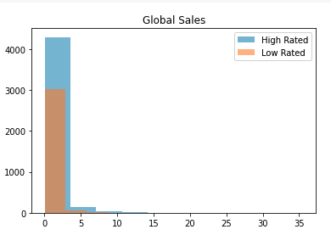
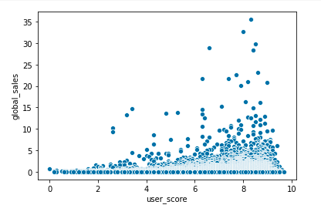
User Score related to Global Sales
Global Sales
User Scores
Global Sales (millions)
This difference in mean sales is $292,502
T-test statistic=7.743408149067681, p-value < .05

Slide 8
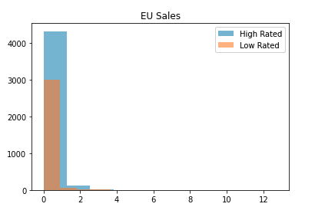
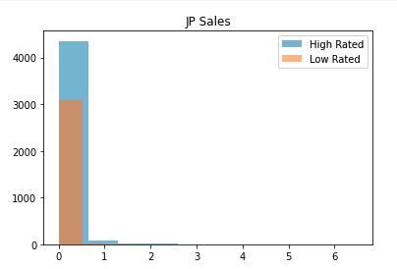
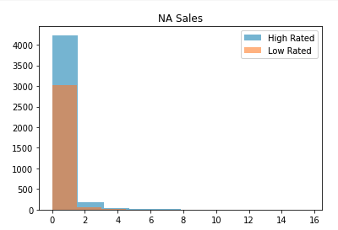
Three Major Markets: The difference in mean sales
Europe
Japan
North America
Sales (millions)
T-test Statistic=5.1983676387382145
p-value < .05
Sales (millions)
T-test Statistic=9.439137328844026
p-value < .05
Sales (millions)
T-test Statistic=7.4628650260236284
p-value < .05
$69,025
$59,317
$138,494

Slide 9
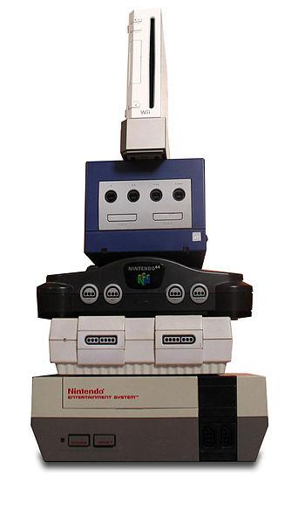
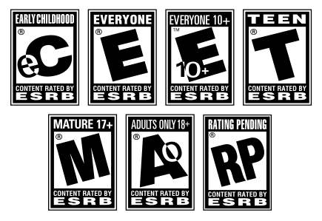

Other Variables
Platform
ESRB Rating

Slide 10
Conclusions
The initial results indicate the user score has a significant relation to the global sales of a video game.
The relation appears to be consistent across markets, ratings, and platforms, with some small exceptions.
Higher User Score = Better Sales

Slide 11

Next Steps

Slide 12
Recommended Studies
A detailed analysis of specific markets
Analysis repeated with critic scores
Study comparing the factors that affect the user scores of games

Slide 13

Questions?

